Slide 1
UAV Detection
Uri Yallow, Yoav Raytsfeld
Course: Applied AI and Data Science Studio

Slide 2
Background & Motivation

Slide 3
Background & Motivation
1. The Real World Problem
Classify flying objects—specifically UAVs and birds—using only radar trajectory data.
Identify the object type sample-by-sample as data arrives, with reliability improving as the trajectory unfolds.
2. The Challenge: Ambiguity in Radar Data
Spatial Overlap: Birds and drones often have indistinguishable static 3D coordinates.
Dynamics are Key: Identity is revealed through motion dynamics (acceleration, turn rates), requiring analysis of how the object moves over time.
3. The Gap: Why Conventional Models Fail
Batch vs. Streaming: Conventional models often require fixed-length feature extraction (e.g., "wait for 10 seconds"), forcing offline batch analysis.

Slide 4
Research Goals & Objectives
Distinguish flying object types using motion over time
Compare model based filters vs learned sequence models
Generate Simulations of UAVs trajectories

Slide 5
Methodology

Slide 6
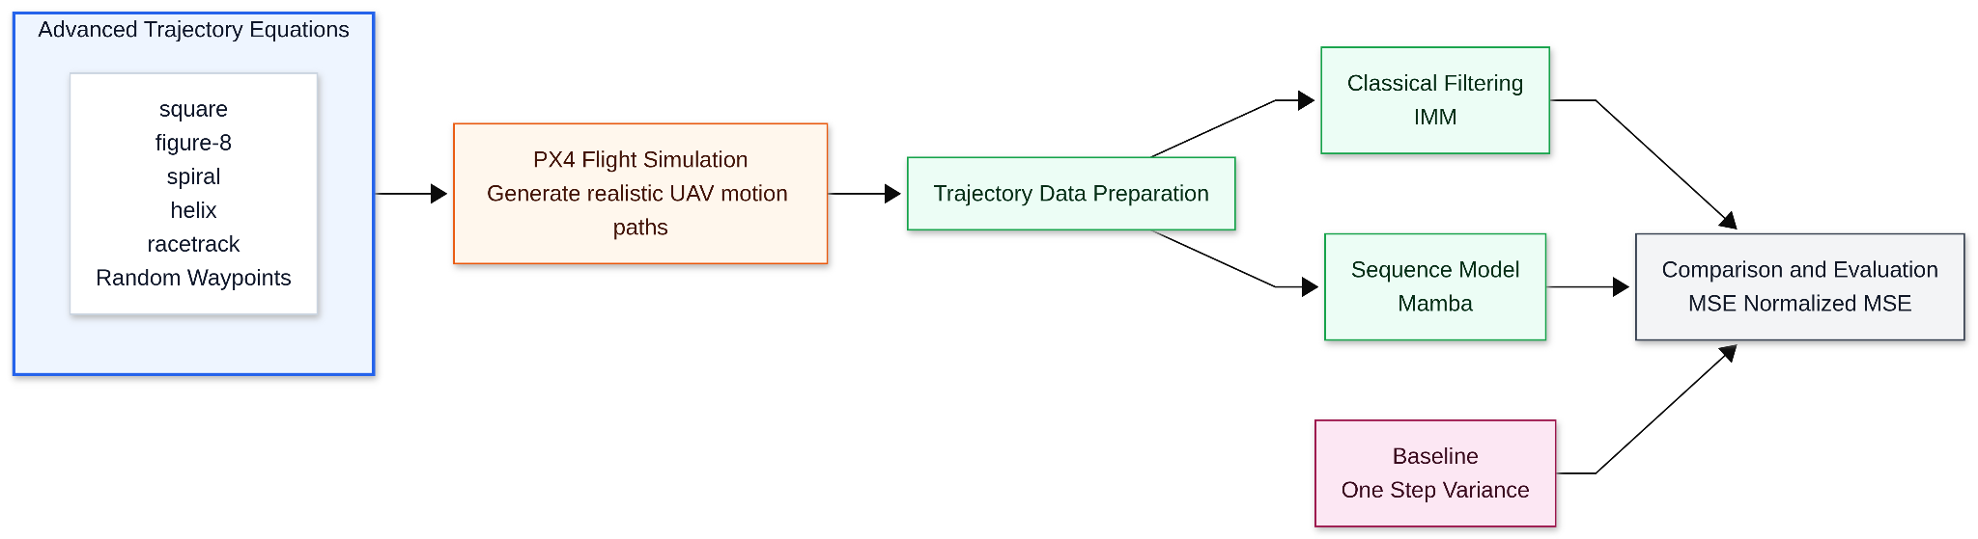
Methodology

Slide 7
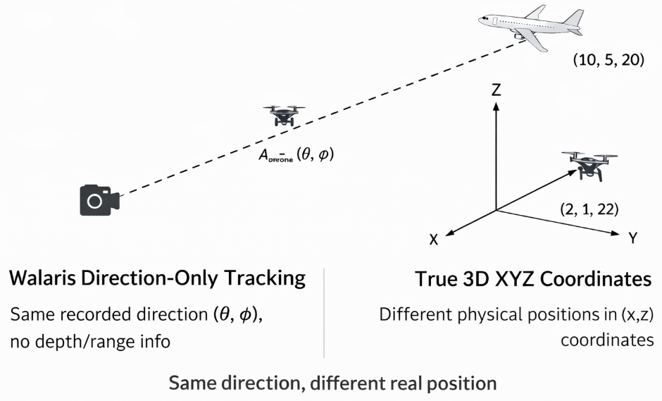
Synthetic Trajectories Motivation
Why Synthetic and Simulated Data Is Required
No real labeled radar trajectory dataset is available
kinematic motion equations alone fail to capture execution behavior, control constraints, and noise

Slide 8
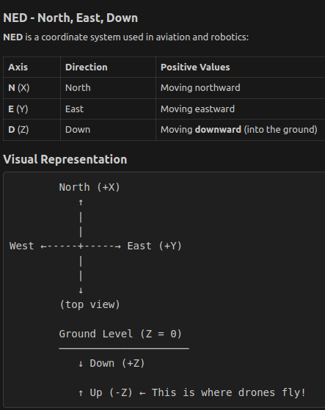
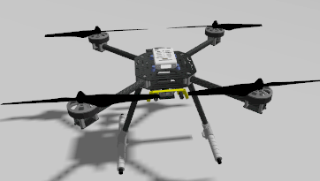
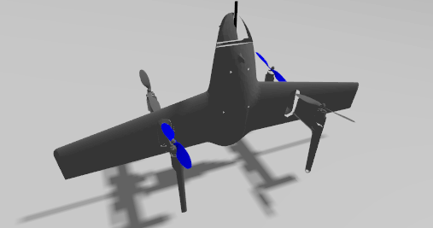
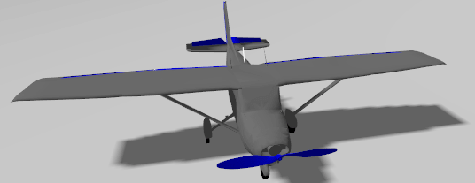
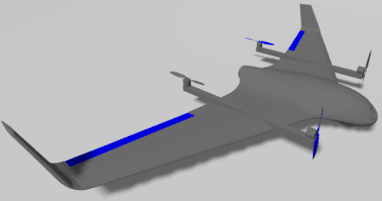
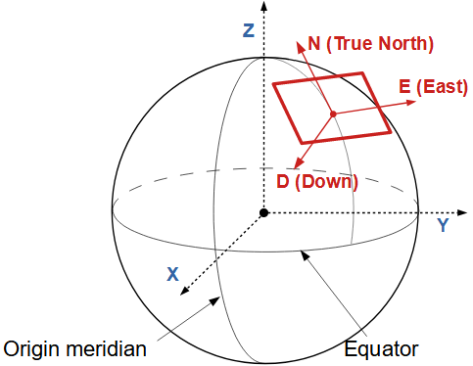
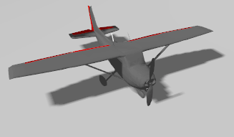
PX4 Autopilot Simulation Overview
gz_x500
gz_quadtailsitter
gz_rc_cessna
gz_tiltrotor
gz_advanced_plane

Slide 9
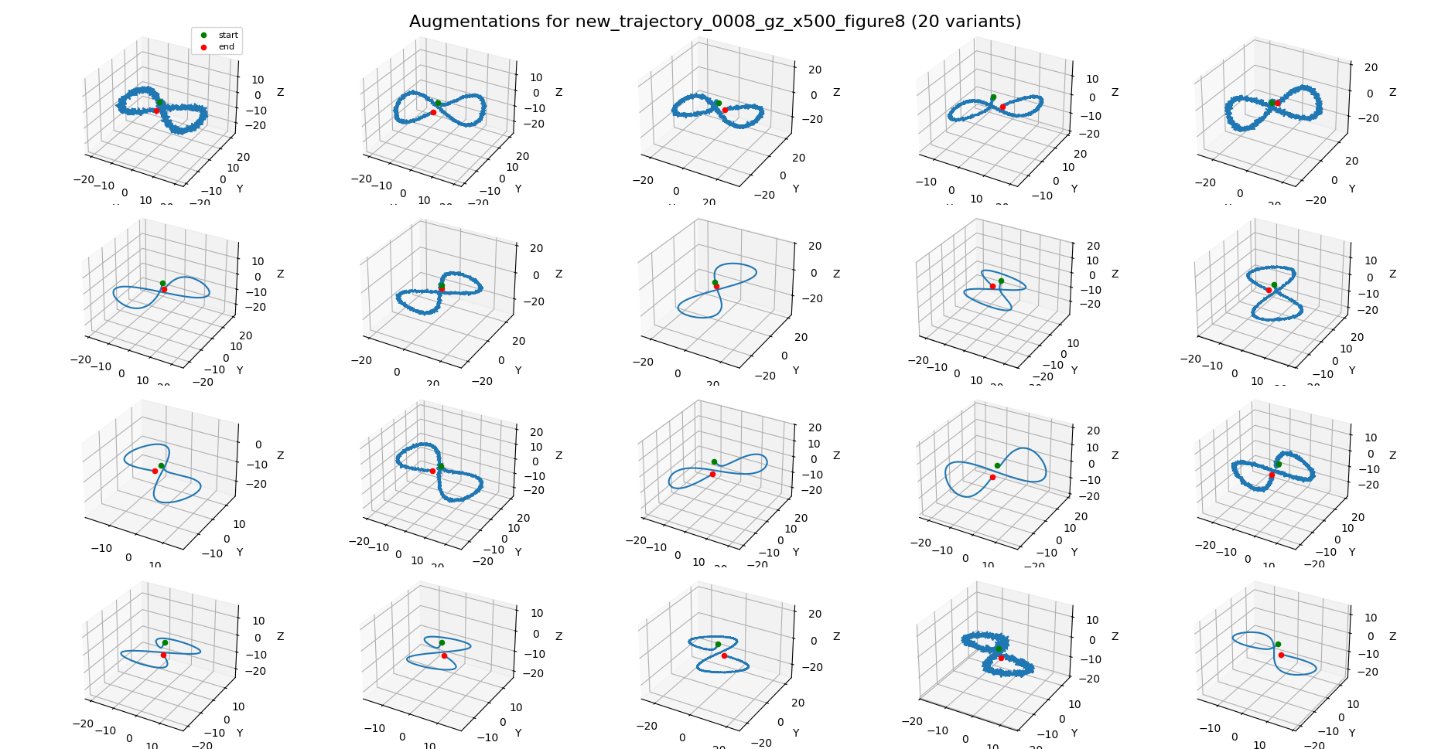
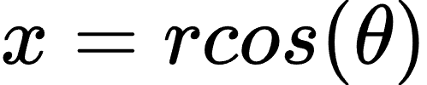
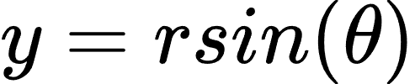
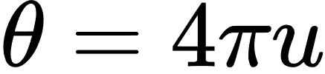
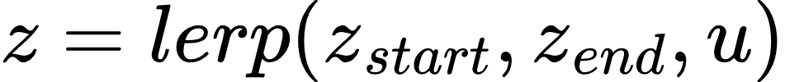
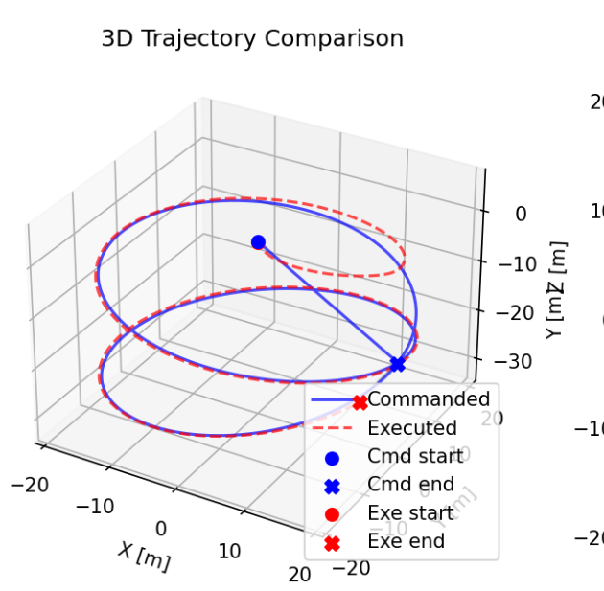
Simulation-Based Trajectory Generation
Motion Trajectory Generation
Trajectory Variants
Helix:

Slide 10
Sequence Learning vs Probabilistic Motion Models
Aspect | Mamba (SSM) | IMM Filtering
Modeling type | Fully data driven | Physics model driven
Motion knowledge | Learned implicitly from trajectories | Predefined motion equations
Training required | Yes, offline learning | Yes online learning, for covariance initialization (Q, R)
Prediction style | Direct next step regression | Predict/update filtering cycle
Adaptation | Learned weights capture behavior | Switches between motion modes probabilistically
Interpretability | Black box | Transparent states + mode probabilities
Dependency on dataset quality | High | Medium (Sensitive to calibration data)
Strength | Captures complex patterns | Stable and robust for known dynamics
Weakness | Needs large representative data | Limited to modeled motion types

Slide 11
Interacting Multiple Model (IMM)
Role: The "Manager" that fuses the linear and non-linear models.
Concept: Runs competing physics models (AKF + EKF) in parallel and blends their outputs.
The IMM Cycle:
Interaction (Mixing): Pre-mixes state estimates based on the probability of switching flight modes (Markov Chain).
Filtering: Each model predicts the next state independently using its own physics (Linear AKF vs. Turning EKF).
Probability Update: Reweights each model based on how well it predicts the new measurement.
Combination: Final estimate is the weighted average of both filters estimates.
Outcome: Enables "soft-switching" between maneuvers (e.g., straight > turn) without the lag of a single filter.

Slide 12
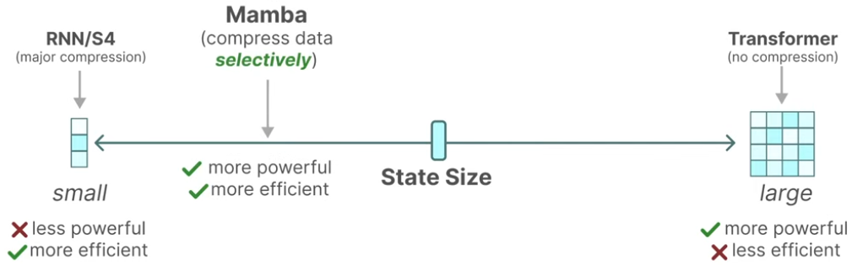
Mamba Model: Why SSM
Aspect | RNN / LSTM | Transformers | Mamba (SSM)
Temporal Processing | Sequential | Parallel | Parallel scan
Memory Mechanism | Implicit hidden state | Full pairwise attention | Explicit state space memory
Long Range Memory | Vanishes over time | Preserved via attention | Stable state memory
Complexity vs Sequence Length | O(T·H) | O(T²) | O(T·H)
Memory Usage | O(H) | O(T²) | O(H)
Behavior on Long Trajectories | Degrades | Accurate but heavy | Accurate and efficient

Slide 13

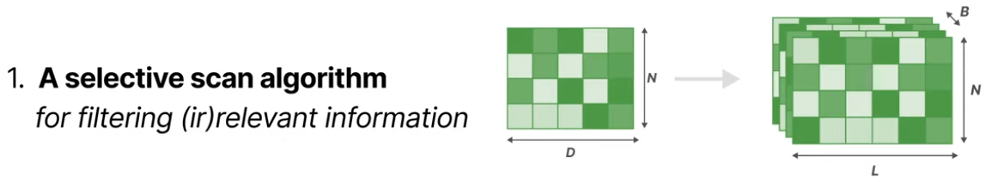
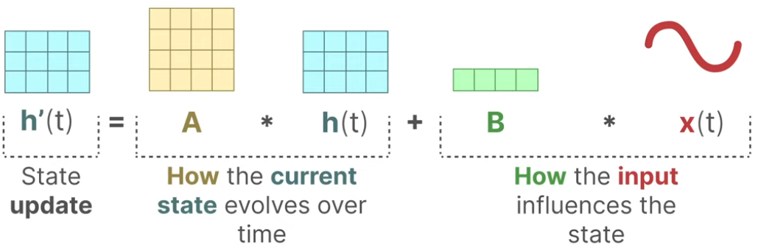
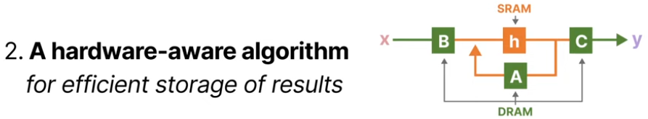

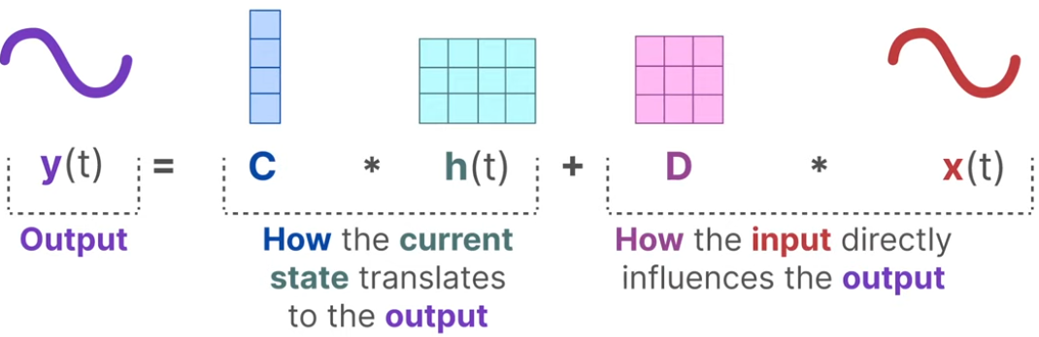
Mamba Model: How it works
SSM models treat sequences as a dynamical system:
Mamba Implementation Mechanisms

Slide 14
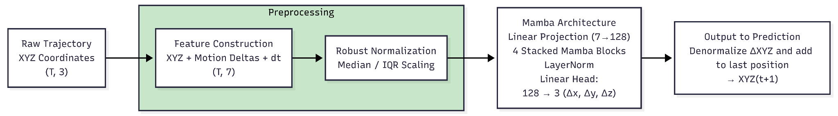
Mamba Model: Training Procedure
Unique Training Techniques
Training Configuration
Input / Window
Sequence length: 48 time steps
Horizon: 1 step ahead
Feature vector per step: [x, y, z, dx, dy, dz, dt]
~1K trajectories per scenario
Training Setup
Optimizer: AdamW
Learning rate: 1e-5
Batch size: 128
Epochs: up to 15–20 (early stopping active)
Component | Purpose
Robust scaling (median + IQR) | Reduce sensitivity to extreme values
XYZ + Deltas | Provide motion information, not only location
Huber Loss | It behaves like MSE for small errors and like L1 for large errors, and is calculated on delta prediction.
Delta prediction | Learn motion rather than absolute coordinates

Slide 15


Evaluation Framework
Task: One-step-ahead prediction (t+1) based on historical window (t-N to t).
Metrics:
Normalized MSE: Relative performance vs. a naive benchmark.
Naive Benchmark:
Logic: The simplest prediction is to assume the object remains stationary at the current location.
Prediction Equation:
Calculating the MSE of this benchmark yields the variance of these single-step increments

Slide 16
Contributions

Slide 17
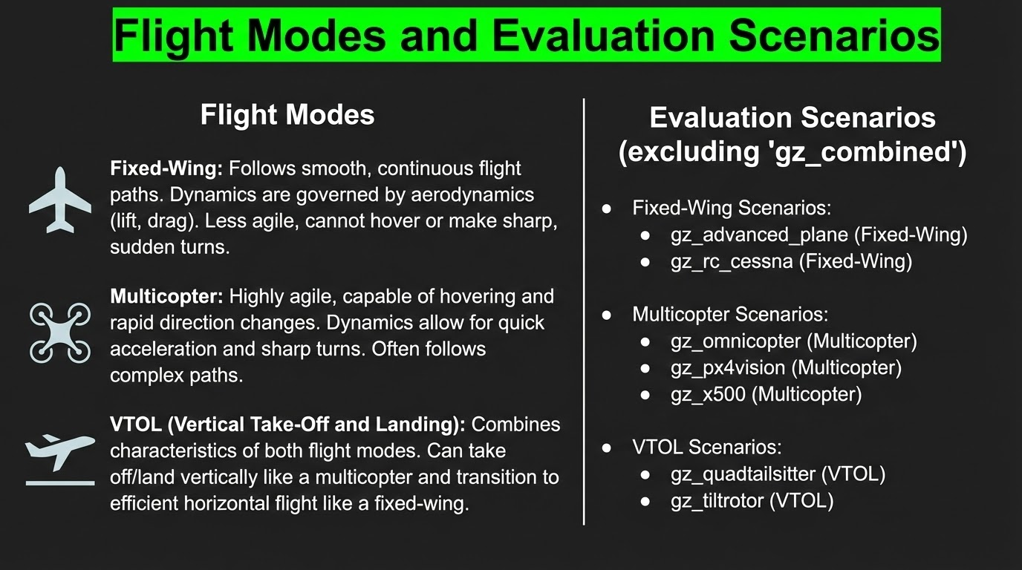

Slide 18
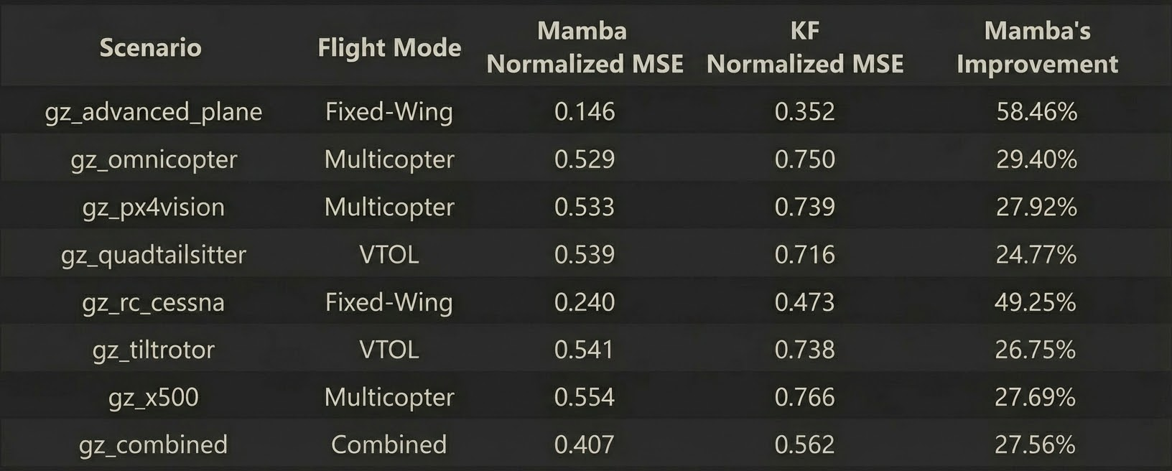
Mamba vs KF: Universal Improvement
Mamba outperforms KF in all 8 scenarios
Largest gains in “Fixed-Wing” mode (‘gz_advanced_plane’: ~58%, ‘gz_rc_cessna’: ~49%)
Consistent 25-30% improvement in “Multicopter”, “VTOL” and “Combined” scenarios

Slide 19
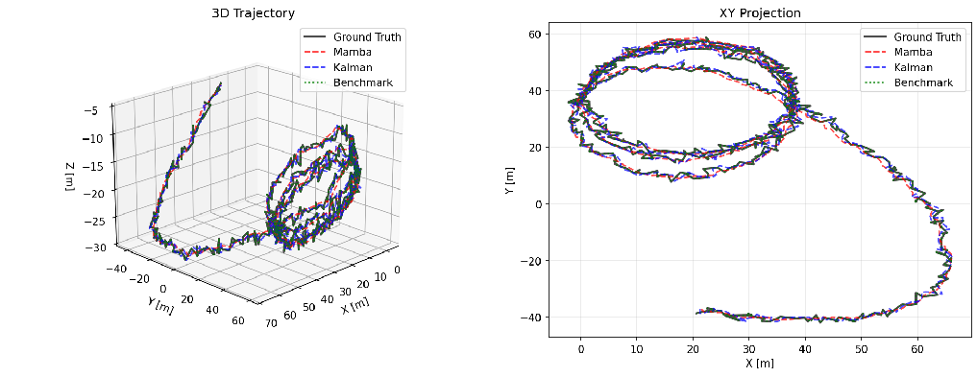
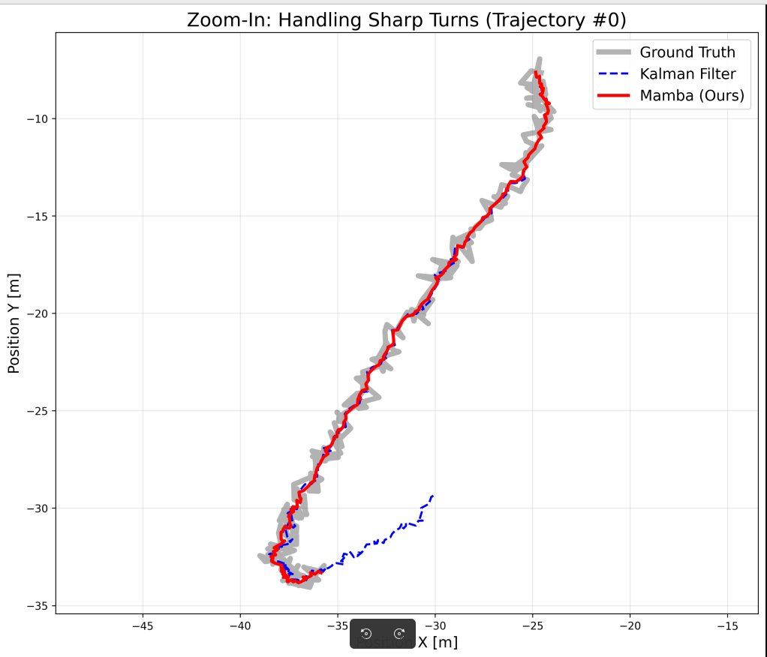
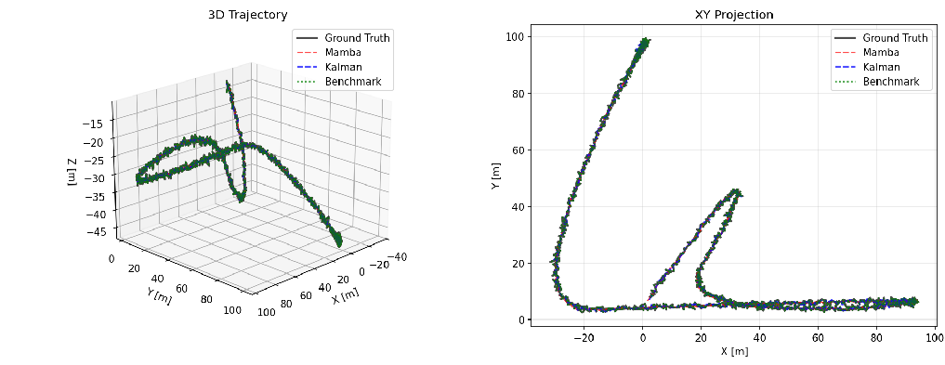
Models Prediction Plots

Slide 20
Conclusions and Future Work

Slide 21
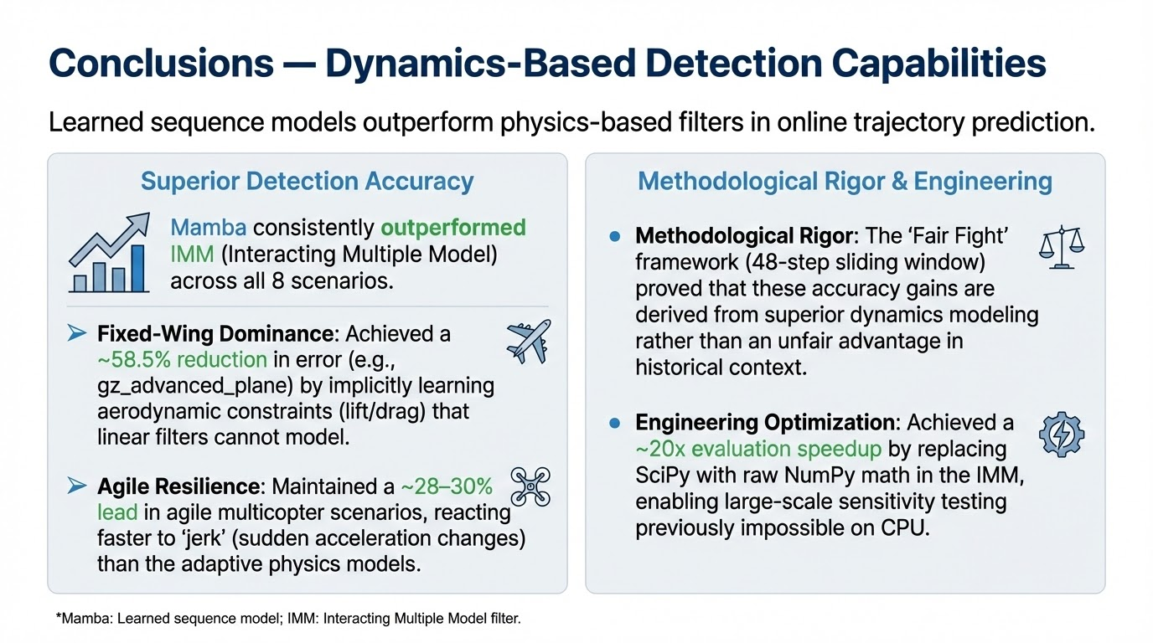

Slide 22
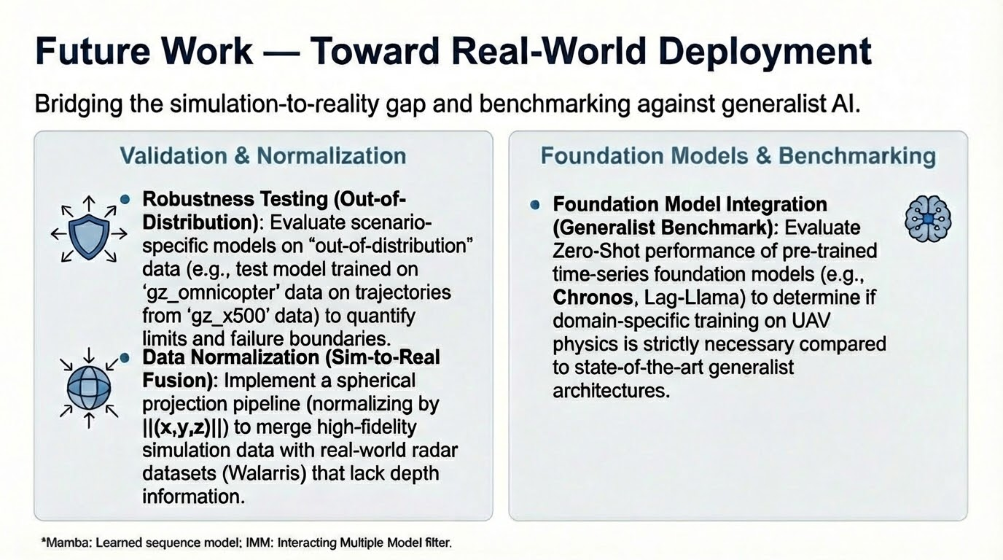

Slide 23
Thanks All
Q & A

